Slide 1
Substitution Matrices
Markov Chains

Slide 2
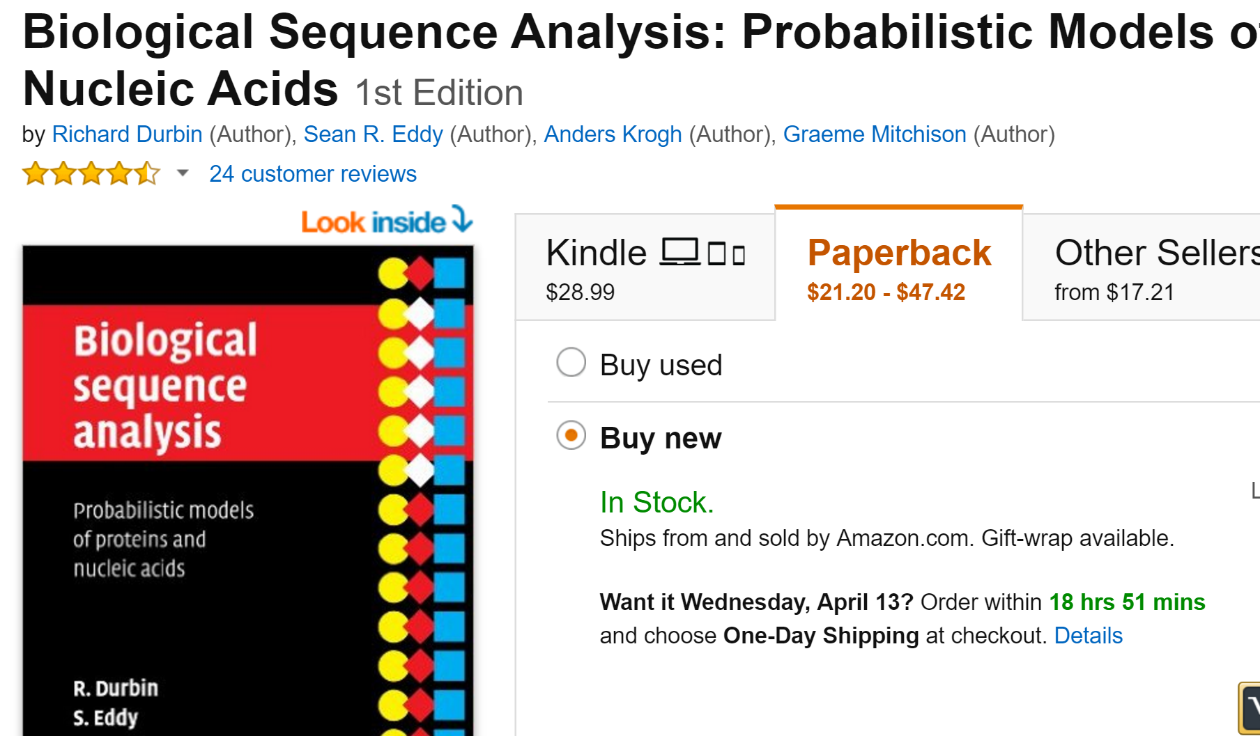
Here we follow the Durbin et al. book…

Slide 3
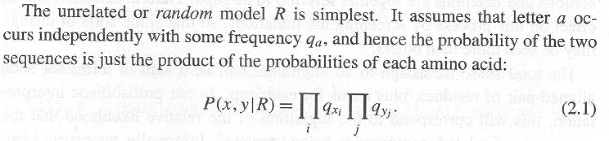
Consider some protein alignment….
ELVIS-
ELVIRA
How do we score this alignment?
How do we generate it?
This our background model.
The probability of any alignment given just “rolling” the sequences of the alignment with a 20 sided die where the odds of getting any aa is the frequency of that residue in our training set (PFAM, SWISS-PROT, whatever)

Slide 4
The background frequencies in SwissProt…
public static final char[] RESIDUES = new char[] { 'A', 'C', 'D', 'E', 'F', 'G', 'H', 'I', 'K', 'L', 'M', 'N', 'P', 'Q', 'R', 'S', 'T',
'V', 'W', 'Y' };
public static float BACKGROUND[] =
{0.072658f, 0.024692f, 0.050007f, 0.061087f,
0.041774f, 0.071589f, 0.023392f, 0.052691f, 0.063923f,
0.089093f, 0.023150f, 0.042931f, 0.052228f, 0.039871f,
0.052012f, 0.073087f, 0.055606f, 0.063321f, 0.012720f,
0.032955f};

Slide 5
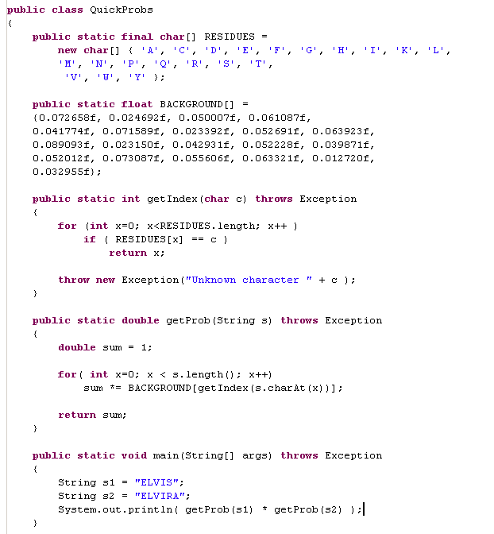
ELVIS-
ELVIRA
P(x,y|RandomModel) = P(x,y|R)

Slide 6
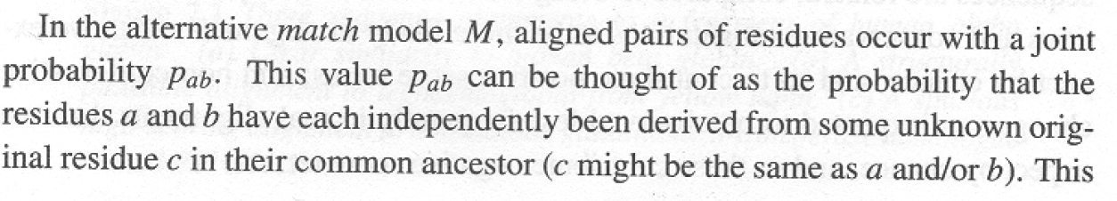
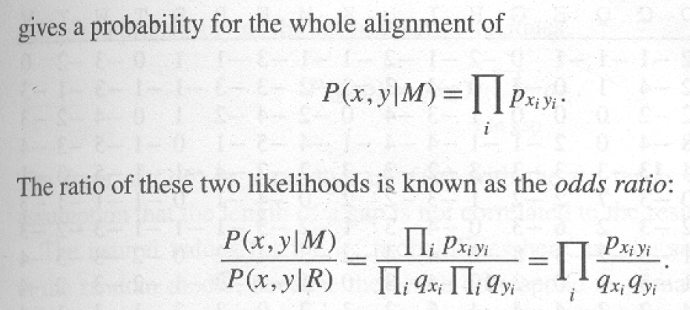
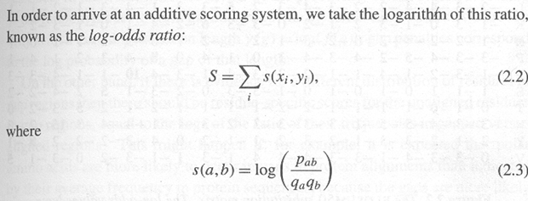
By itself, the random model is not very interesting, but it is part of the log-odds ratio…
This provides the definition of a substitution matrix

Slide 7
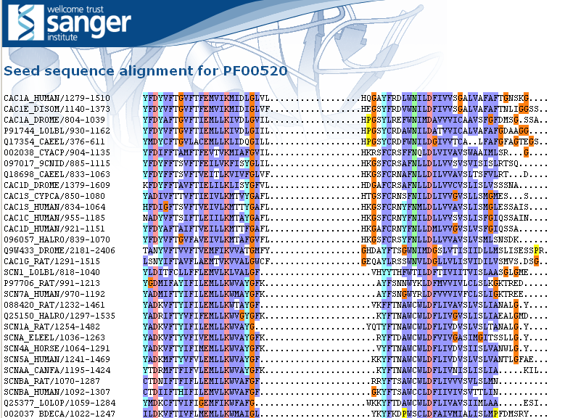
Let’s calculate p(x,y|M) naively
We’ll define p(x,y|M) as the frequency of seeing a pair of residues aligned against each other from the first 25 pfam families…
Considering all pairwise sequences in the alignment, how often do we see each substitution?

Slide 8
Let’s calculate p(x,y|M) naively
We’ll define p(x,y|M) as the frequency of seeing a pair of residues aligned against each other from the first 25 pfam families…
Considering all pairwise sequences in the alignment, how often do we see each substitution?

Slide 9
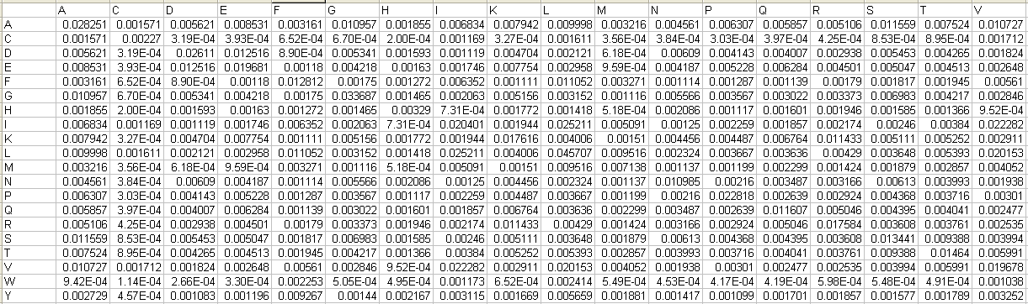
And here is (part of our) triangle
These are the probs
dervied from our
Alignments.
“A to A” is observed as 0.028251
of all pairs in the alignment..
For any pair of residues in an alignment, we have the top and the bottom
calculated
We are now ready to derive our simple substitution matrix….

Slide 10
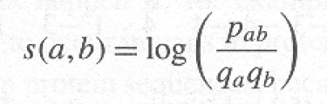
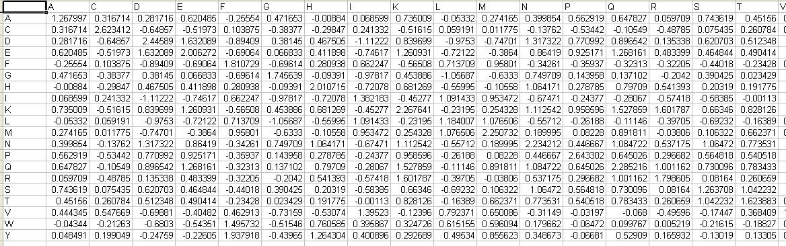
Here is (part of our) substitution matrix triangle

Slide 11
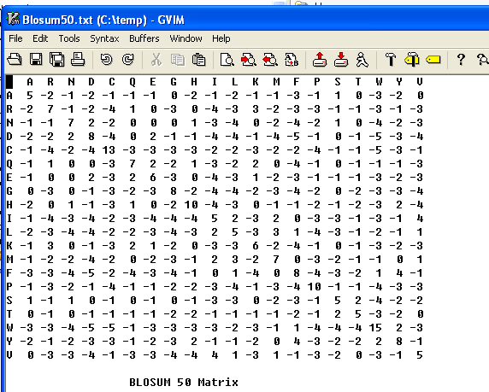
How does our naïve substitution matrix compare to a real one?
(E.g. Blosum50?)

Slide 12
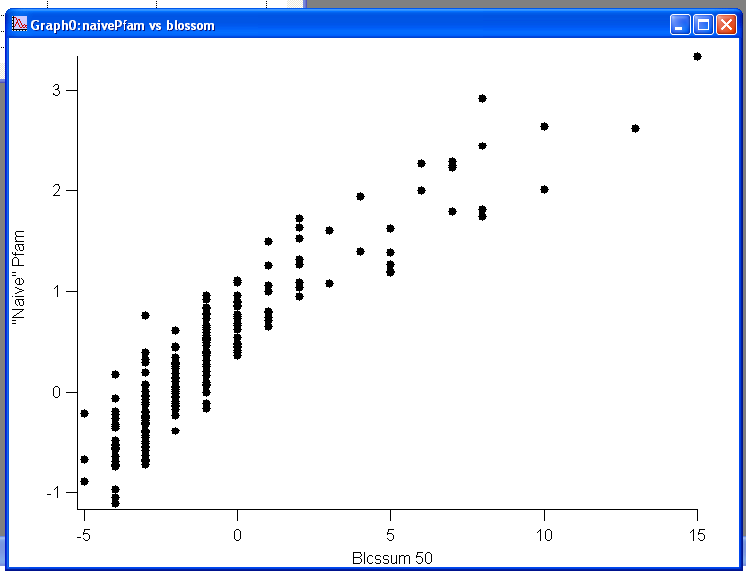
Our “naïve” substitution matrix, not so different from Blossum!
Of course, we are just “rediscovering” the substitution matrix PFAM uses…

Slide 13
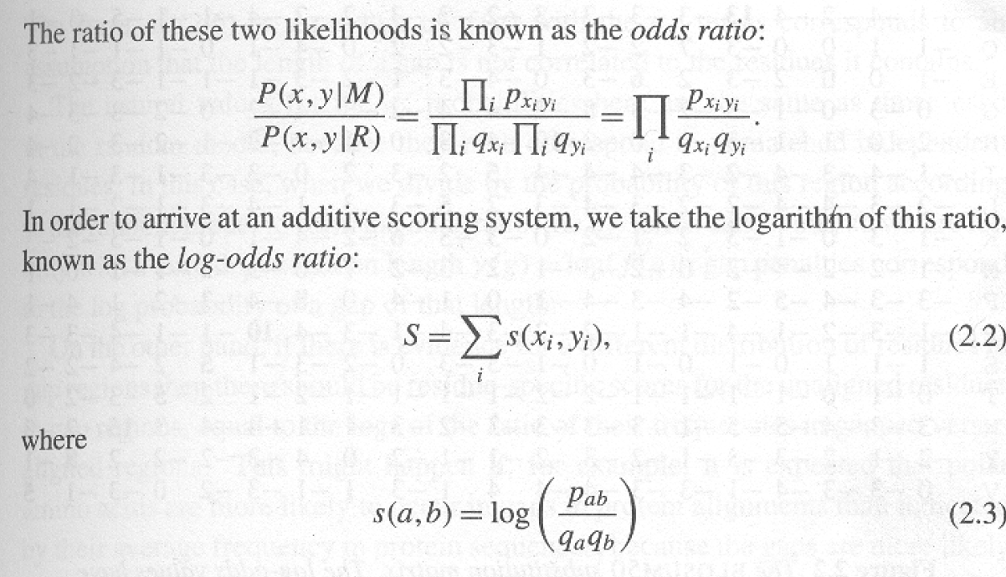
A substitution matrix is just a description of a training set
What you expect from matched residues
s(a,b) = log
What you expect from unmatched residues
If s(a,b) is positive, the substitution is more likely to happen than chance.
If s(a,b) is negative, the substitution is less likely to happen than chance.

Slide 14
This is the “score” of the alignment…

Slide 15
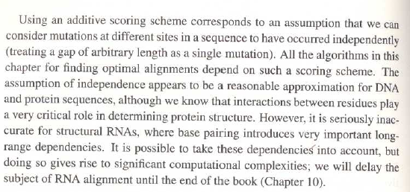
A key assumption is independence. What happens in one
part of the sequence does not effect another..
This is a terrible assumption for structural RNA…

Slide 16
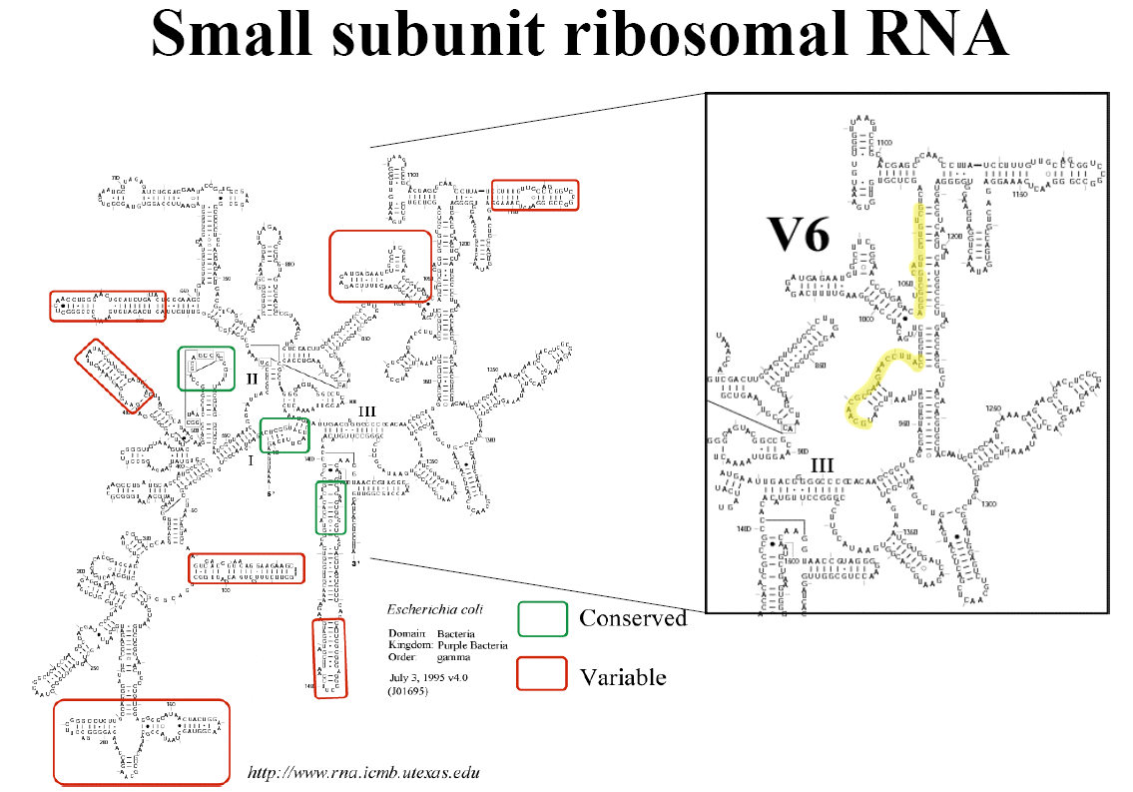
This is a terrible assumption for structural RNA…
Structural RNAs have their own alignment algorithms (which we
won’t talk about this semester…)

Slide 17
Markov Chains

Slide 18
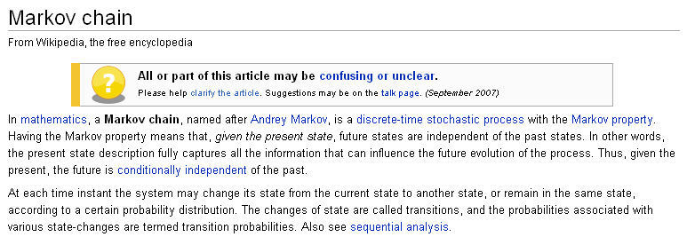
Markov chains have no memory. “Future states are independent
of the past states”.
Markov chains at each time instant can change from one state
to another state (or remain the same) with given probabilities..

Slide 19
Here we follow the Durbin et al. book…

Slide 20
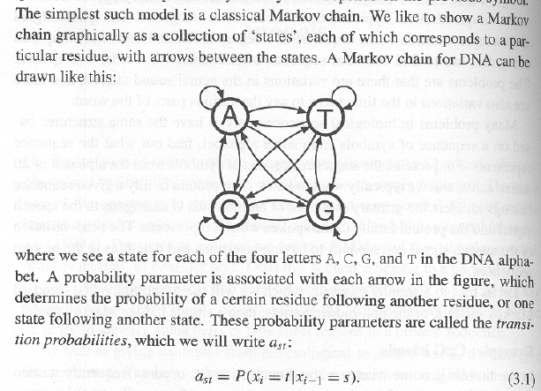
Consider a simple model for DNA dinucleotide frequencies
The probability of moving from state s to t does not
depend on the previous history of where you’ve been.
(No memory)
So if you are in “A”, there is a certain probability of staying in
“A” or moving to “C”, “G” or “T” but that does not depend in this
model on the previous sequence.

Slide 21
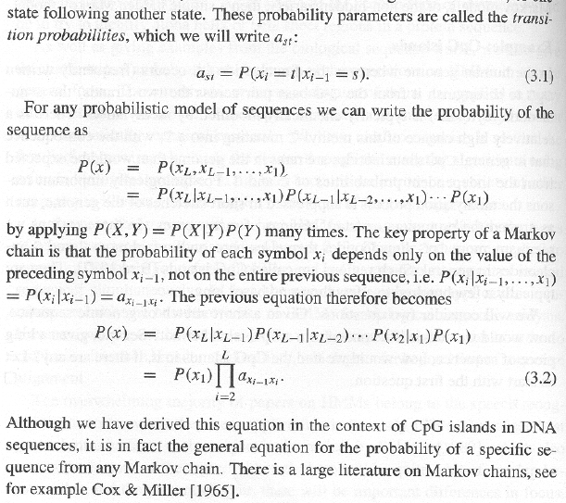
This lack of memory means you can write the probability of
having moved through a particular set of states very easily!
a_{st} is the prob. of
moving from state s to t
P(X) is the probability of traversing all states X₁ to X_{L}
Just the probability of the first state multiplied by every state transition

Slide 22
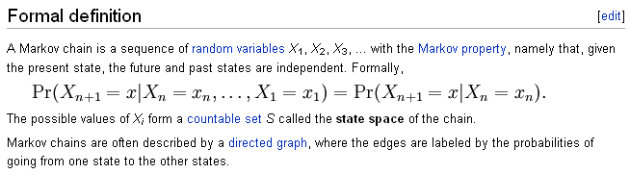
The same math shows up on the Wiki page…

Slide 23
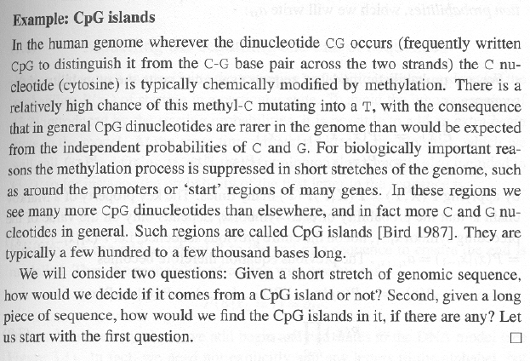
A simple markov chain to score CpG islands…
1
2
CG s can be methylated…
But this methylation is suppressed near active genes…
Question 1 is addressed by Markov chains.
Question 2 is addressed by Hidden Markov Models

Slide 24
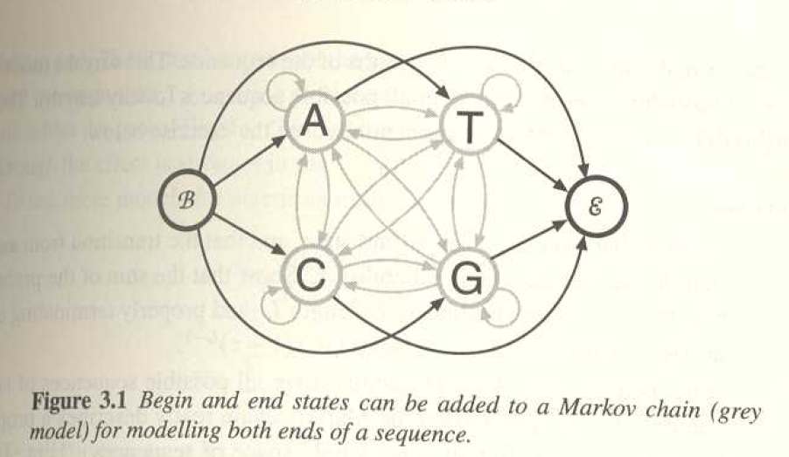
Question 1: Given a short stretch of genomic sequence, how would
we decide if it comes from a CpG island or not?
Here is our model. We have added an explicit begin and end state.
This means that we have some expectation about how long the
sequence that we are looking at will be because there is some
probability with each transition that we will transition to the end
state.

Slide 25
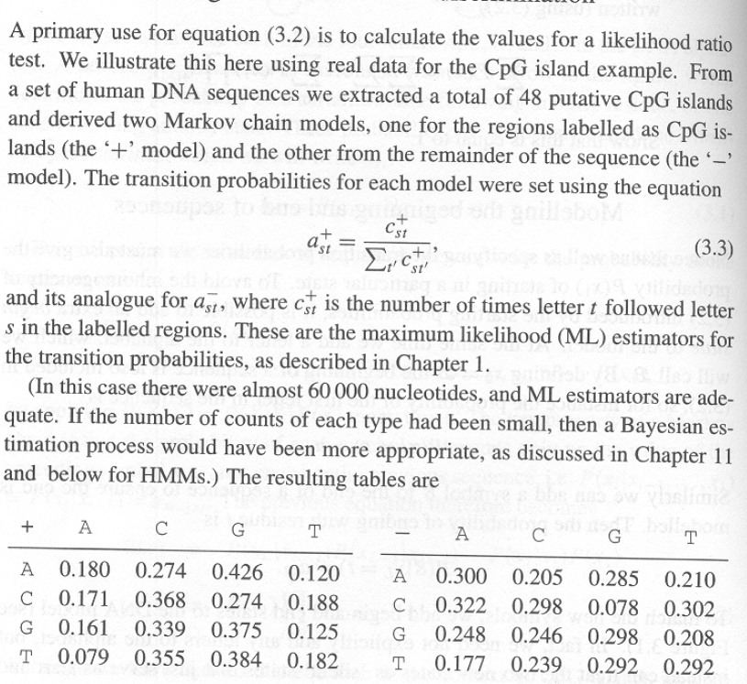
Like almost everything else in this book, we need to define a training
set…
They take 60,000 nucleotides in which 48 CpG islands have been
identified. Then they count the frequency of each dinucleotide.

Slide 26
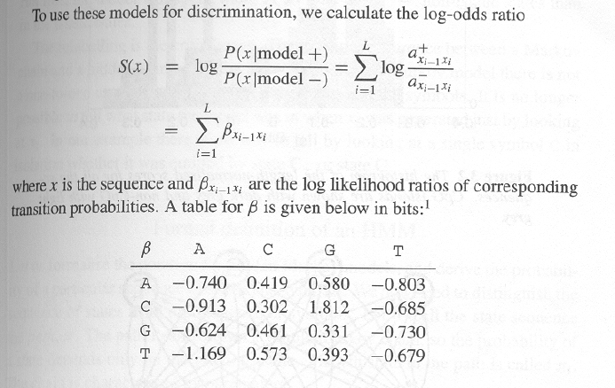
The next part should look pretty familiar from Chapter 2.
We make a “substitution matrix” for our dinucletoide frequencies.
Given a first nucleotide, what is the probability of seeing a second one?

Slide 27
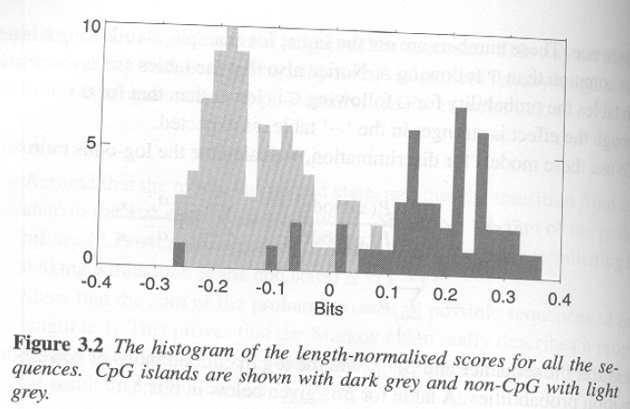
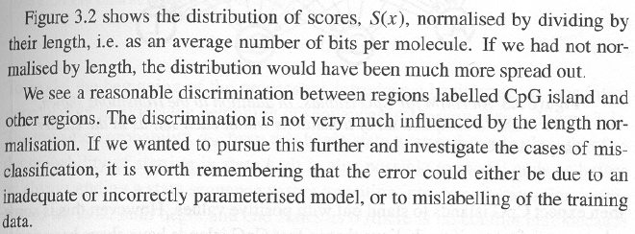
The 16 parameter model does a reasonable job of describing
the data from which it is derived…

Slide 28
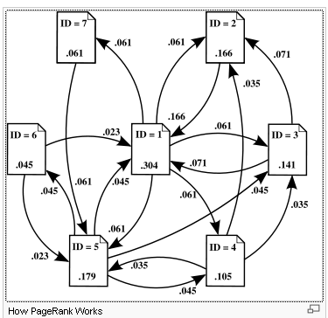
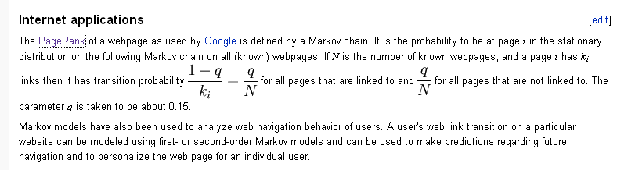
The most lucrative algorithm in history is a Markov chain…
The
The “states” are web pages and
the transitions between them are
the links from web page to web page.
Use the Markov chain to calculate
the probability that a person clicking
on random links would be directed
to a given web page…
Those web pages with many links
by other pages with many links are
ranked higher by Google

Slide 29
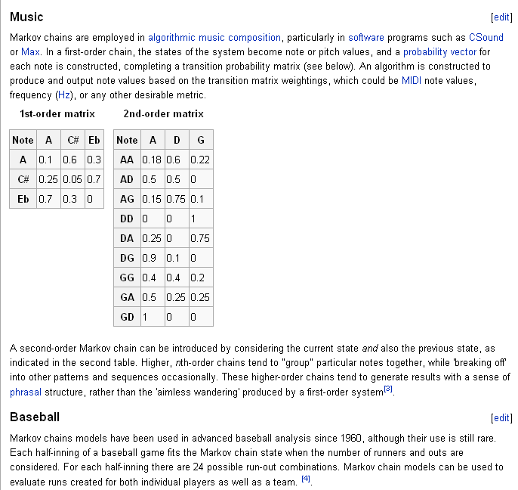
Pretty much anything can be modeled with Markov chains

Slide 30
Next, we want to think about the second question…
Given a long piece of sequence, how would we find the CpG islands
in it, if there are any?
We could take our scoring scheme and apply it to the genome sequence
With a given window size (say 100 base pairs)
A reasonable approach, but there is a potentially more powerful alternative

Slide 31
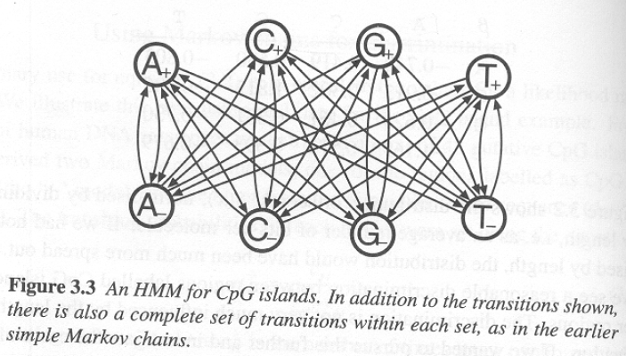
A hidden Markov Model (HMM)
Many parameters (there are 32 parameters not drawn here)…
Given a sequence, we wish to know the states that generated that
sequence.
The states are hidden. We observe symbols. We then infer the states
that are most likely to have emitted the observed symbols.

Slide 32
In this model A+,A- emit A
C+,C- emit C
G+,G- emit G
T+,T- emit T
Given a sequence, the challenge is to find whether we are in
the + or – states.

Slide 33
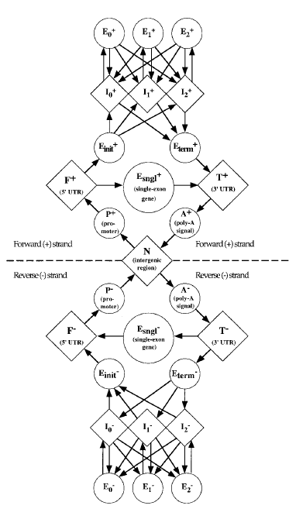
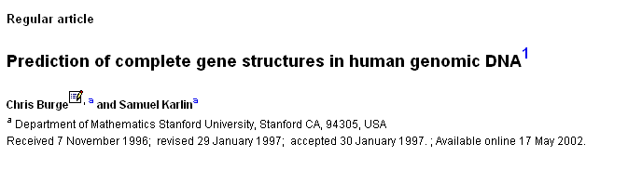
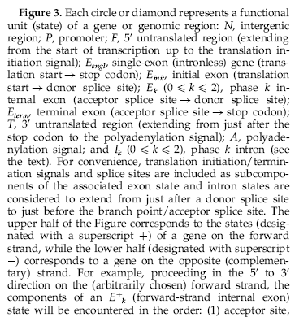
Genscan. A venerable gene prediction algorithm for
predicting genes in genomic DNA. HMM.
(cited ~2,508 times)

Slide 34
In Chapter 3, we’ll learn.
Given a sequence, what is the most probable
annotation of that sequence.
We have some sequence and we would
like to construct a path of states through
some model that is the best
explanation of that sequence.
We are going to apply this with very simple
2 state models.
But the math is the same no matter how
simple or complex the model…

Slide 35
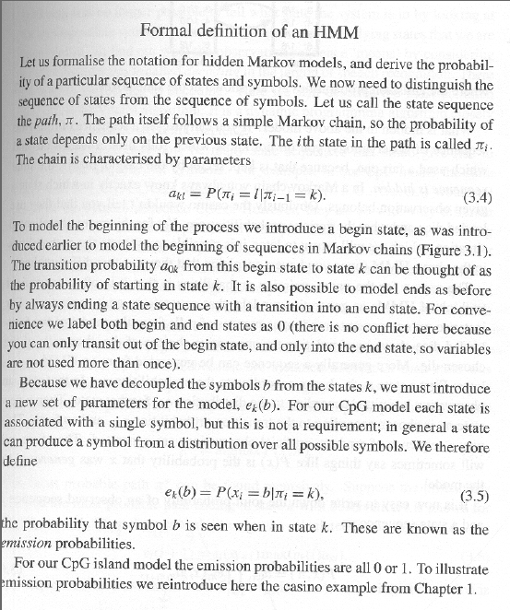
π is the path of states
(usually not known)
a_{kl} is the probability of
Going from state k to l
a₀ is the initial state (and confusingly the same label for a separate end state!)
For symbol b, e_{k}(b) is the prob. that you observe symbol b given that you are in state k

Slide 36
We can now describe this more formally…
In this model A+,A- emit A
C+,C- emit C
G+,G- emit G
T+,T- emit T
For a given nucleotide i in the sequence we observe b
P(b_{i}=A|k_{i}=A+) = 1
P(b_{i}=C|k_{i}=A+) = 0
P(b_{i}=G|k_{i}=A+) = 0
P(b_{i}=A|k_{i}=A-) = 1
P(b_{i}=C|k_{i}=A-) = 0
P(b_{i}=G|k_{i}=A-) = 0
P(b_{i}=T|k_{i}=A+) = 0
P(b_{i}=T|k_{i}=A-) = 0

Slide 37
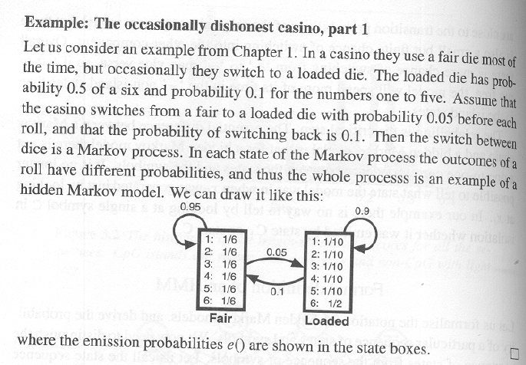
In the GpC HMM each state π_{i} emits only one symbol (A,C,G or T).
To show a more interesting case, they reintroduce the
occasionally dishonest casino…

Slide 38
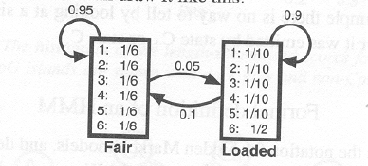
Describing this formally as an HMM…
P(b_{i}=1|k_{i}=fair) = 1/6
P(b_{i}=1|k_{i}=loaded) = 1/10
P(b_{i}=2|k_{i}=fair) = 1/6
P(b_{i}=2|k_{i}=loaded) = 1/10
P(b_{i}=3|k_{i}=fair) = 1/6
P(b_{i}=3|k_{i}=loaded) = 1/10
P(b_{i}=4|k_{i}=fair) = 1/6
P(b_{i}=4k_{i}=loaded) = 1/10
P(b_{i}=5|k_{i}=fair) = 1/6
P(b_{i}=5k_{i}=loaded) = 1/10
P(b_{i}=6|k_{i}=fair) = 1/6
P(b_{i}=6|k_{i}=loaded) = 5/10

Slide 39
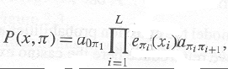
Assuming we start in State1..
What’s the probability of rolling a 1 and a 3 with the
fair die and then a 6 with the loaded die?
(1)(1/6) *
(0.95)(1/6) * (0.05) * (.5)
We start
in the fair state
We roll a
1 in the fair state
We stay
in the fair
state
We roll a
3 in
the fair state
We move
To the
loaded
state
We roll a
6 in
the loaded state
The joint prob. of
the traversal of the state-path
and the emissions
transition prob.
of moving from
state π_{i-1} to π_{i}
Emission prob.
of observing x from
State π_{i}
prob. of starting in the initial state

Slide 40
This is not that useful because we generally don’t know π
(the path through the states).
Much more useful is the most probable path, given the observed
sequence…

Slide 41
We have the sequence. If we know the
most probable path through the Genbank
HMM, we have our gene predictions
for that sequence..

Slide 42
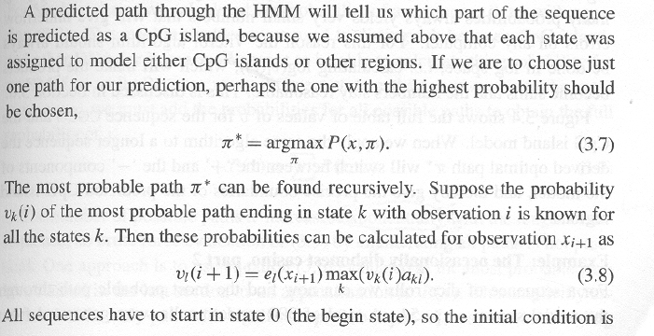
A beautiful recursive algorithm…
π* the most probable path through the system of all the possible paths
(i.e. of all possible π)
v_{k}(i) is the probability of the most probable path ending in state k with observation i

Slide 43
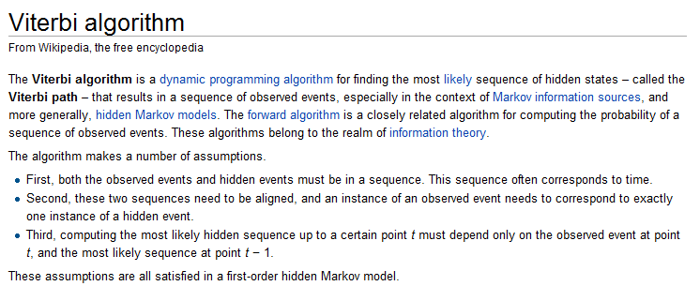
http://en.wikipedia.org/wiki/Viterbi_algorithm

Slide 44
For next time: the viterbi, forward and backwards algorithms

